Slide 1
Ballyduff GAA Development Plan 2021-2026
Investing in our future

Slide 2
Phase 1-2021??
Install final section of existing Walkway to create a community walkway, these works would include the walkway itself, fencing cont. along the side line side ,ducting put in for lights that may need to be upgraded later, upgrade existing lighting to LED floodlighting

Slide 3
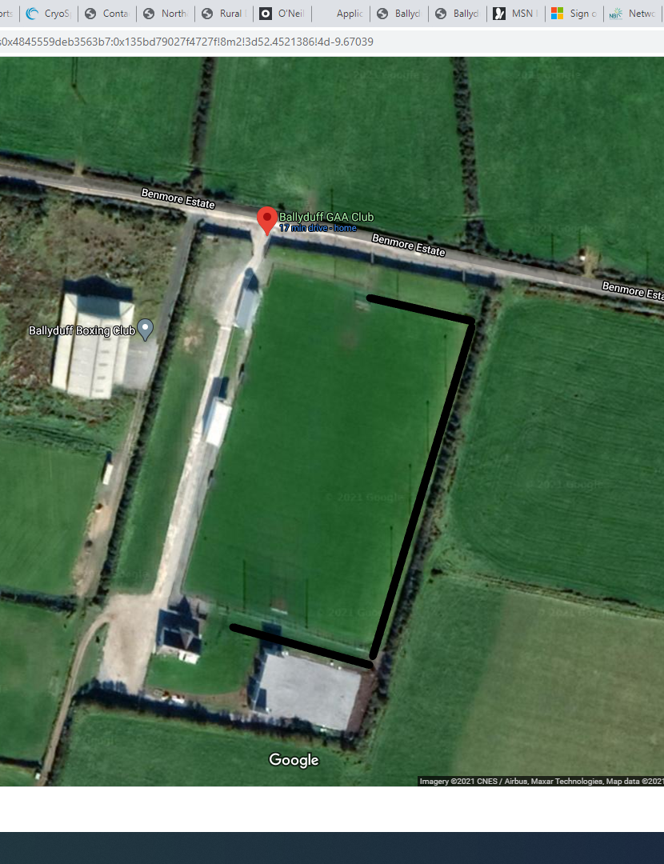
Phase 1
Community Walkway

Slide 4
Phase 1 cont.
Construction of new Gymnasium with recovery room, equipment store,toilets,

Slide 5
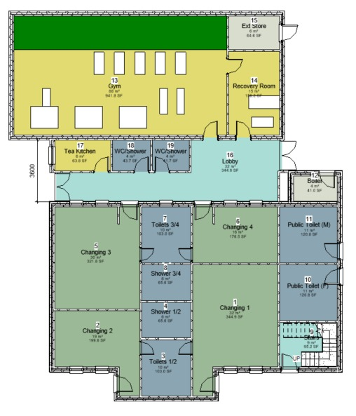
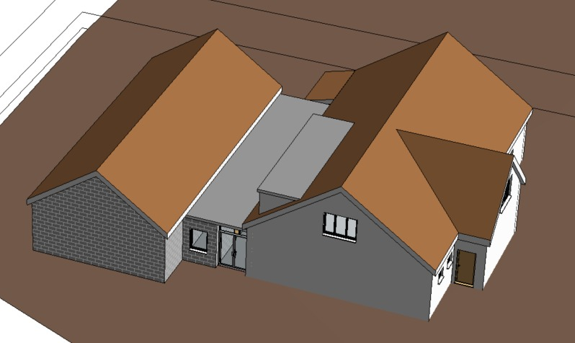

Slide 6
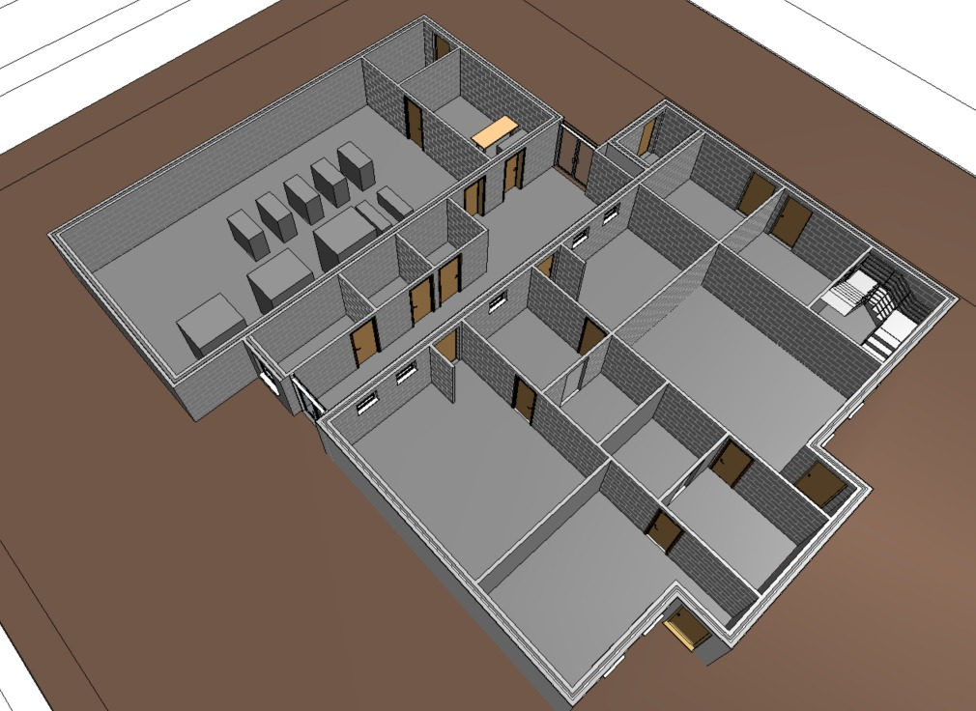

Slide 7
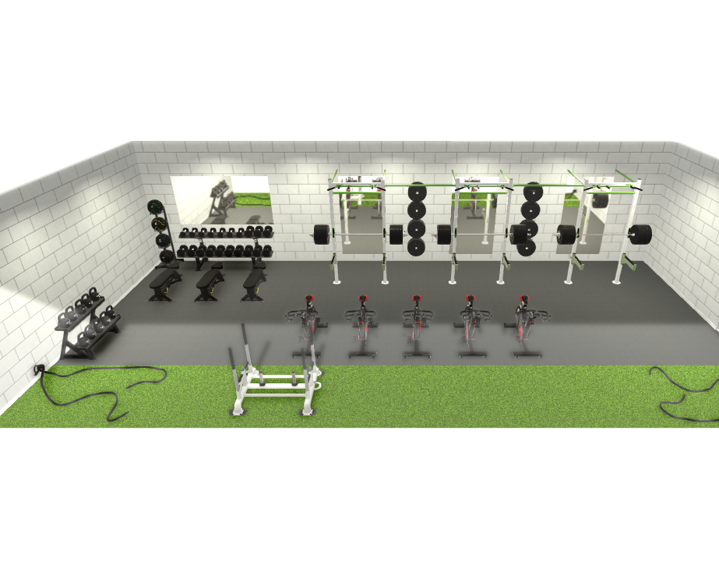

Slide 8
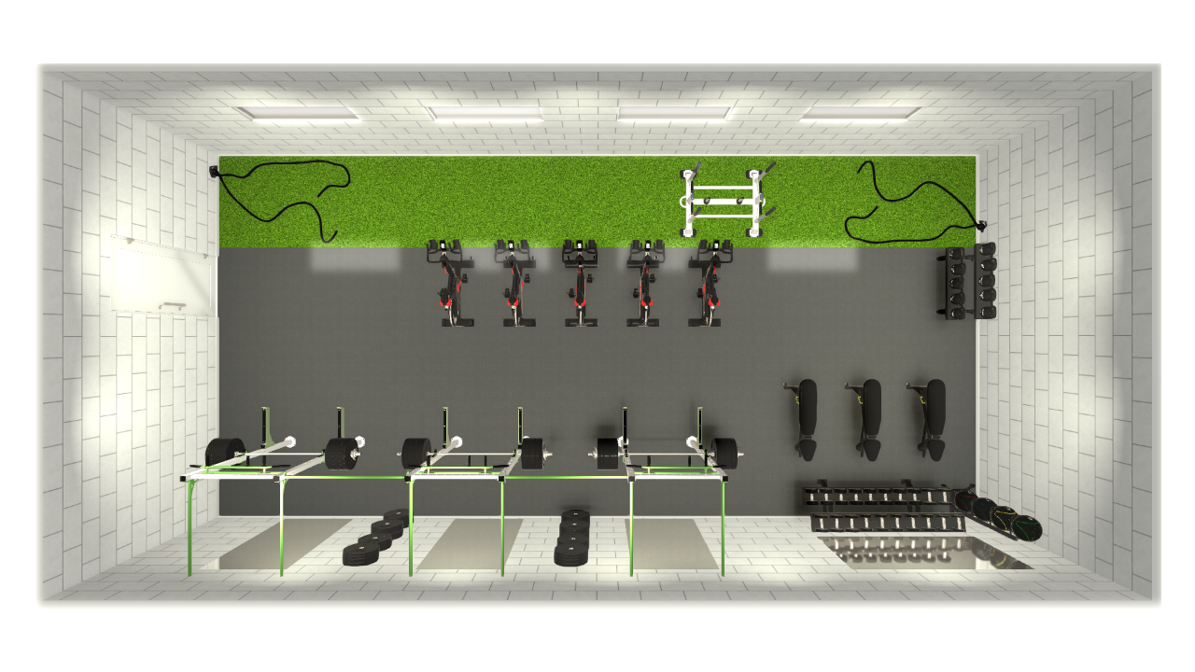

Slide 9
Phase 2-2022
Drain main pitch and top dress so we have a field all year round

Slide 10
Phase 3-2023-2024
Re-develop Upper pitch to have one main pitch with juvenile pitch and an underage training area,all with full drainage & sand based system.

Slide 12
Additional works
Car park realignment & surfacing( Outside/Inside)
Upgrade of stands

